Slide 1


SAFEGUARDING ELECTORAL INTEGRITY: DESIGNING A BLOCKCHAIN-BASED VOTING SYSTEM TO COMBAT ELECTION FRAUD
PRESENTED BY FemmeSec (Group C)

Slide 2
NAMES OF ACTIVE GROUP MEMBERS
Names | Task
Ngwodo Cynthia Ewere | Group C Leader
Serah Chebet Seroney, Blessing Moronke Oyelami | Group C Presenters
Ejiro Rachel Odudu, Vanessa Masupe, Angel Chelsea Adewusi Okpe, Ayeku Esther Oluwapelumi | Slide 3 & 4 Research Group (Magnitude of Problem and Statistics)
Tariro F Gwandiwa, Mufulufheli Mudau, Amune Ofuje Joy, Agrenet Mapalakanye | Slide 5 & 6 Research Group (Factors impacting election integrity) (Blockchain voting system benefits)
Elizabeth Christanah Omorogieva, Nabwile Sifuna, Basirat Kareem, Morenikeji Mary Lamidi | Slide 8 Research Group (Solution’s Case study)
Mary Wanjiku, Oseni Asisat Omowunmi, Olayemisi Omisore | Slide 7 Research Group (Solution)
Endework Abera Zeleke, Apata Oluwatobi Omolade, Lydia Solomon, Priscilla Takon | Slide 9 Research Group (Contribution of solution on SDG 16)
Akinwunmi Adedolapo Marian, Abdulkareem Halimat, Natasha Kalusa, Anya Ijeoma Lorretta, Whitney Chinwe Brightson | PowerPoint Slide Preparation Group

Slide 3

INTRODUCTION
The problem with contemporary voting systems is that they are subject to vulnerabilities, which, if exploited, pose a significant risk of election fraud.
Safeguarding electoral integrity is a critical issue across Africa, where the magnitude of election fraud and its implications for democracy are profound.

Slide 4

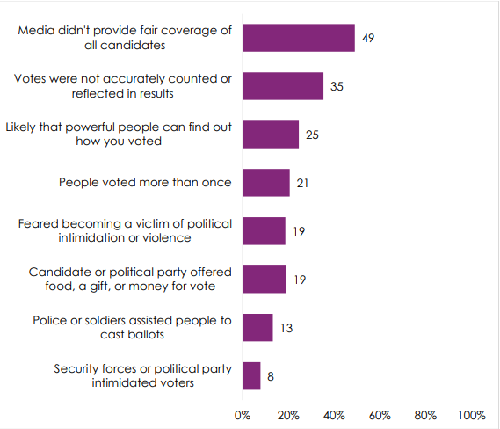



THE ELECTORATE's
PERCEPTION OF ELECTION CREDIBILITY
(34 COUNTRIES)
Afrobarometer 2022

Slide 5
FACTORS IMPACTING THE INTEGRITY OF ELECTION
Manipulation of Information
Equipment Failures and Supply Issues
Alteration or Destruction of Ballots
Counting Errors and Reporting Inaccuracies
Weak Electoral Institutions
Political Manipulation

Slide 6
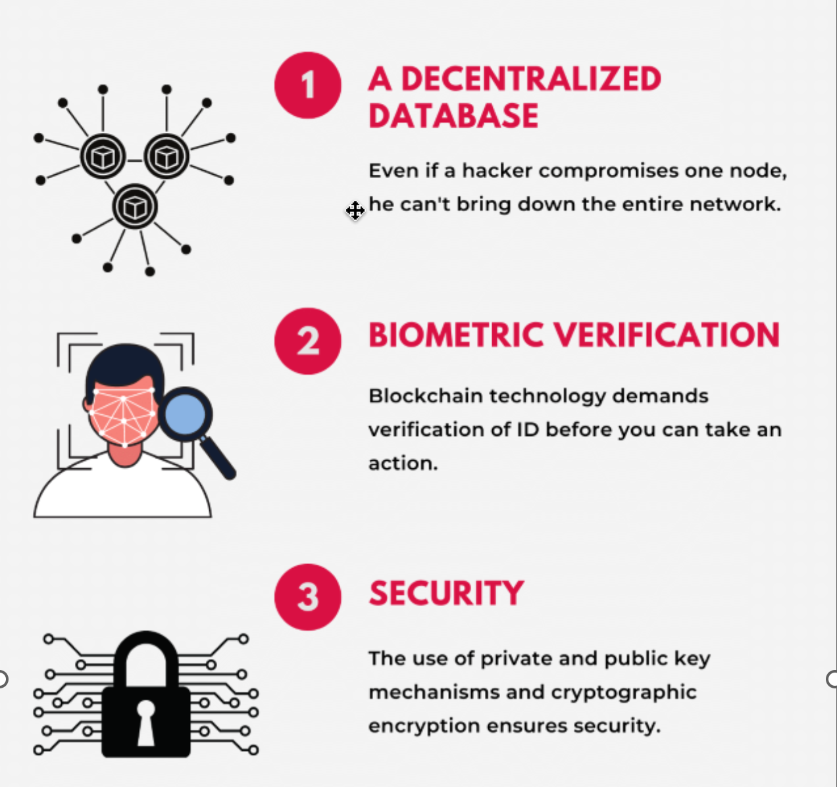
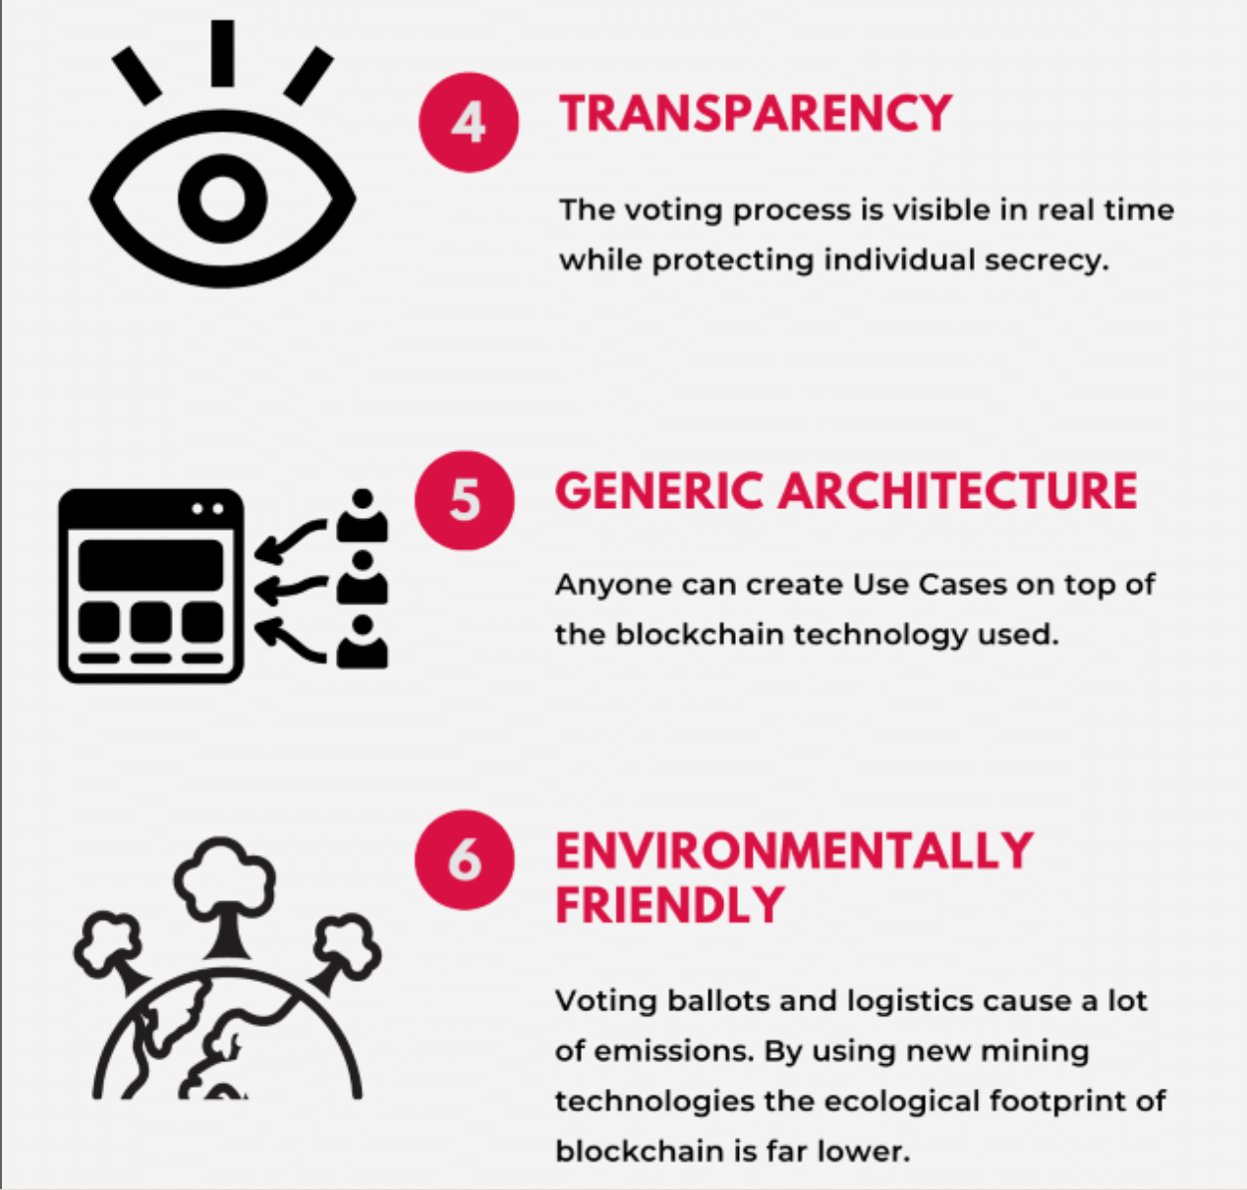
BENEFITS OF BLOCKCHAIN BASED VOTING SYSTEM

Slide 7
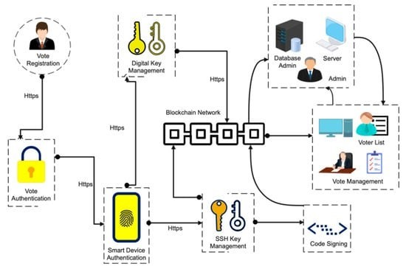
BLOCKCHAIN VOTING SYSTEMS ARCHITECTURAL OVERVIEW (HYPERLEDGER FABRIC)

Slide 8
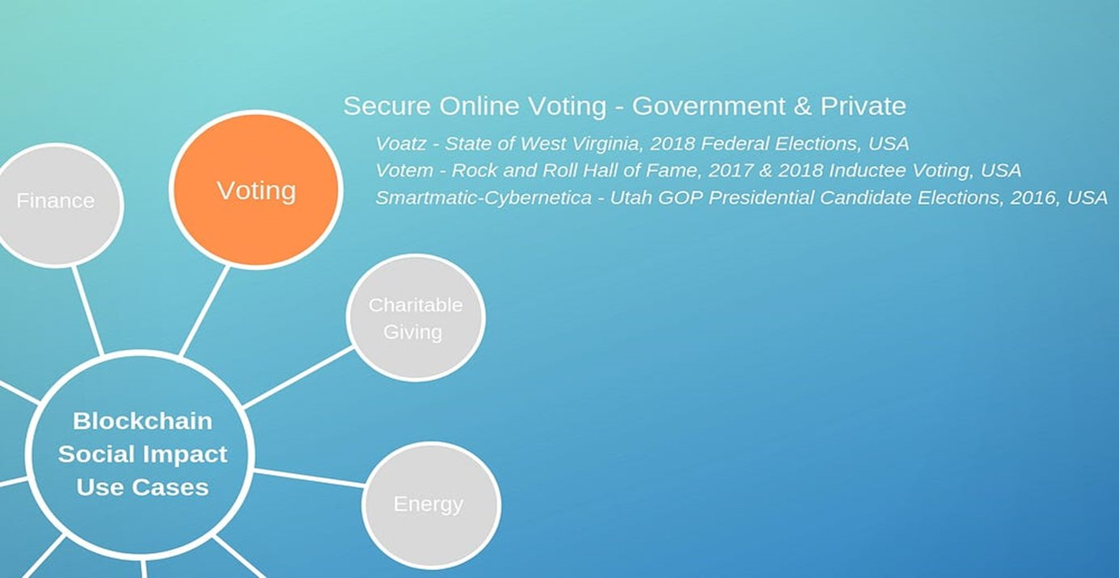
CASE STUDY

Slide 9
CONCLUSION
In conclusion, the implementation of the blockchain-based e-voting system offers secure, transparent, and efficient voting processes. Embracing this technology can revolutionize election systems by ensuring trust and accuracy in the electoral process.
THANK YOU FOR YOUR ATTENTION

Slide 10
REFERENCES
https://www.afrobarometer.org/wp-content/uploads/2022/09/AD549-PAP15-Support-for-elections-weakens-in-Africa-Afrobarometer-Pan-Africa-Profile-6sept22.pdf
https://fastercapital.com/content/Exploring-the-Power-of-Hyperledger-Fabric-in-Blockchain-Technology.html
https://issuu.com/ijraset/docs/online_voting_system_using_block_chain/s/23086203
https://docs.google.com/presentation/d/1r0AOTilkdaKqoW823u44t7fWNtyWkpxEgWV6P1mdqYo/edit#slide=id.g2c18f902d97_0_0
https://www.mdpi.com/1424-8220/21/17/5874

